Slide 1
SCALING REVENUE THROUGH DATA SCIENCE
Joseph Roberts
Matt Rubino
Che Guan
https://github.com/mids-w205/project-3-joethequant
Notes:
Matt

Slide 2
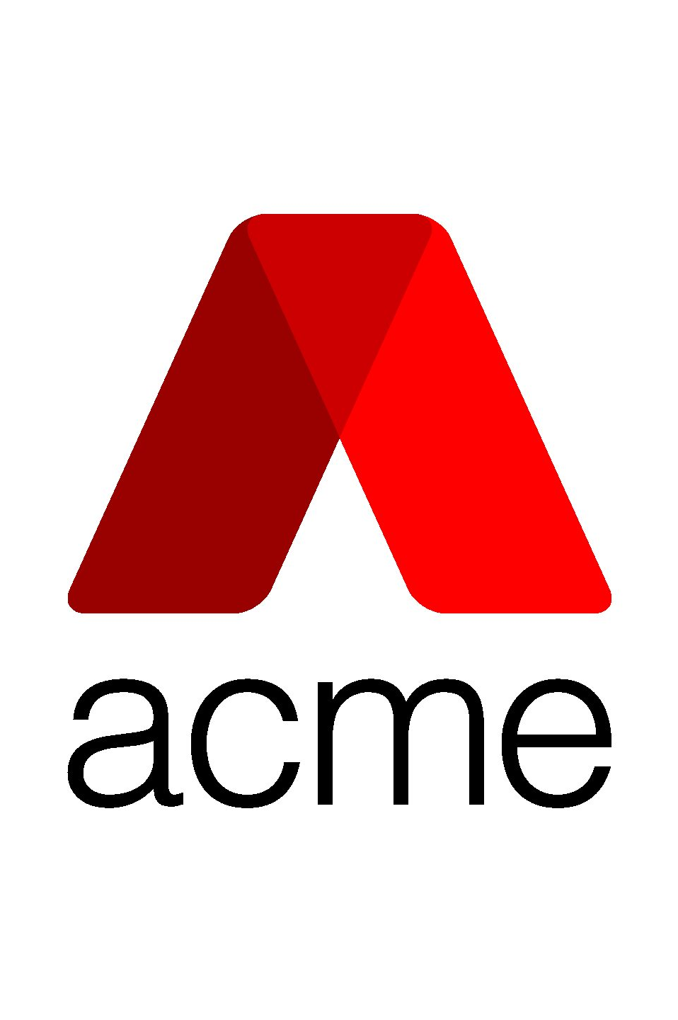
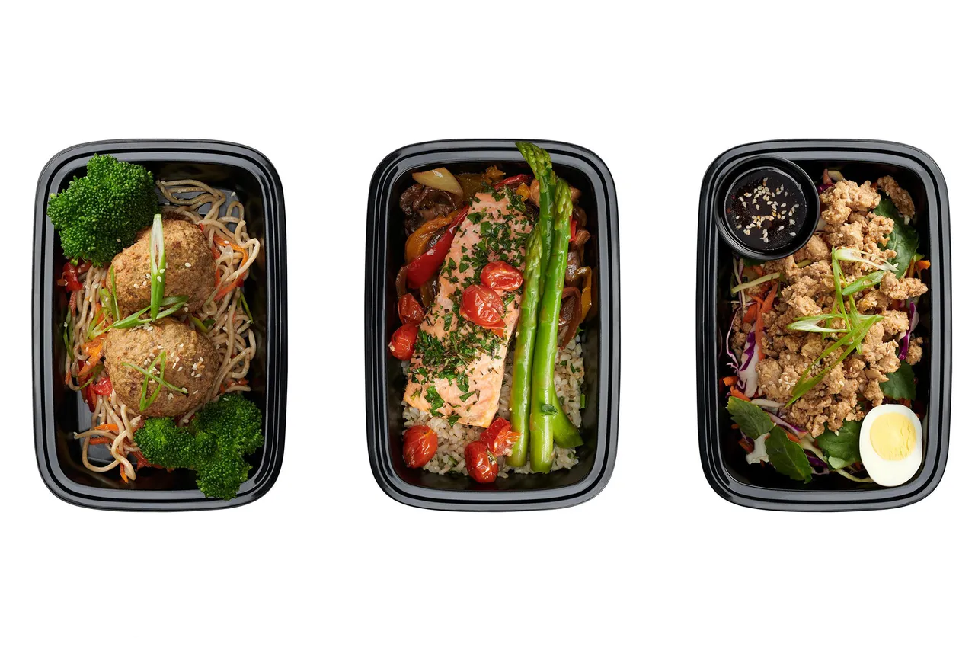
Acme Gourmet Meals (AGM) is an innovative food company that offers healthy, seasonal pre-made meals. It delivers to customers in the Greater Bay Area, focusing on young professionals that are too busy to cook or grocery shop.
Acme Gourmet Meals
01 BACKGROUND
Notes:
Matt

Slide 3

A VISION FOR THE FUTURE
DATA SCIENCE
PROBLEM
Problem Statement: How can AGM optimize delivery and pickup capabilities in the Bay Area to better serve their customers today while positioning the company for long-term growth and success?
Continuous Learning through Data Science: The innovative management team is focused on expanding its store footprint, optimizing delivery in the Bay Area, and iterating on its successes with help of the data science team to drive new ideas, insights, and intuition. It believes the use of data science can lead to an improved margin profile, increased TAMs, and take rates.
SOLUTION
Notes:
Matt

Slide 4


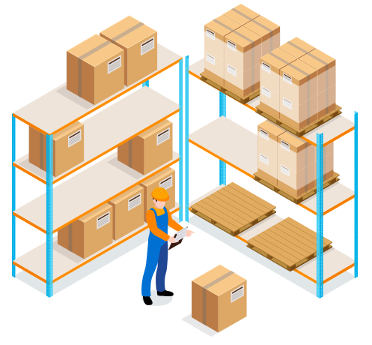
Questions of Interest
What is our target market from the perspective of customer demographics? What are their ages, genders, income levels and primary places of residence?
What times during the day and week tend to lead to peak sales generation? What can we learn from the surrounding areas at such times?
What features will be the best predictor for increasing sales?
Does Betweenness make sense as a variable to optimize?
How will we test and roll out new ideas?
Can we optimize our inventory more efficiently?
Continuous Learning
Notes:
Matt

Slide 5
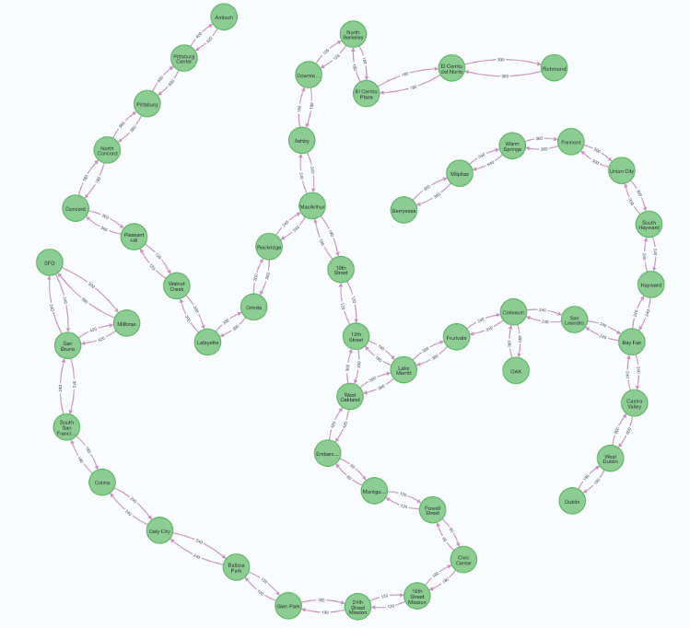
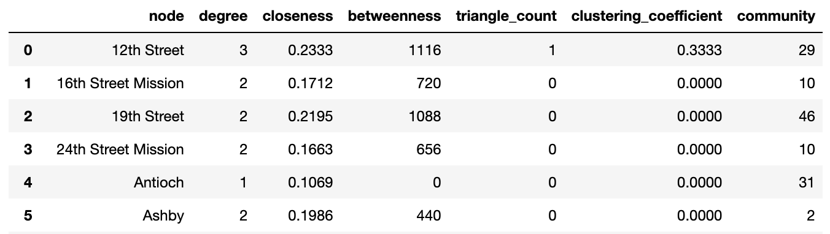
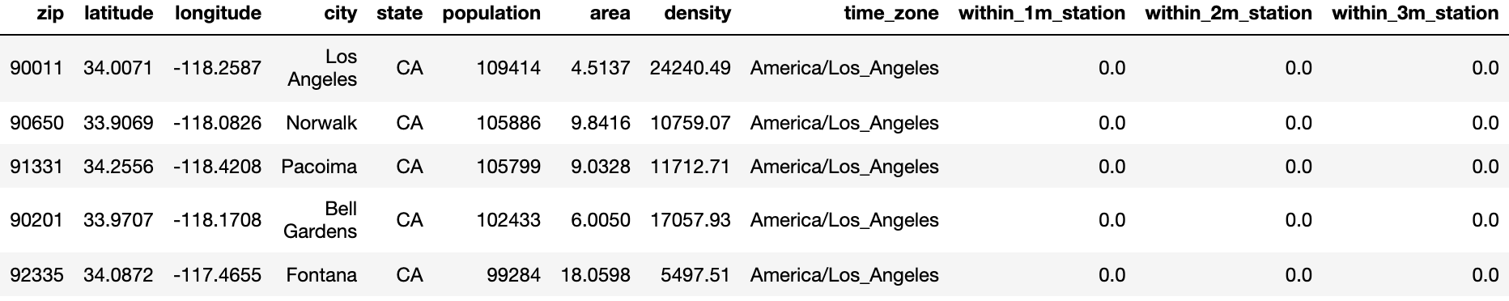
Visualize BART stations and travel time between any two
Features
Degree Centrality
Measures number of relationships a node has in a graph: incoming, outgoing
Closeness Centrality
Measures average of the shortest path distances between a node and all other nodes
Betweenness Centrality
Find all pairs shortest paths (weighted)
Triangle Count
Number of triangles that pass through a node
Clustering Coefficient
Probability that neighbors of a node are connected to each other
Louvain Modularity
Creates a hierarchy of group at different scales
Population within X miles of a zip code
Number of Stations within X miles of a zip code
Notes:
Matt

Slide 6




STRATEGY IMPLEMENTATION TIMELINE
04. Continuous Supply Chain Optimization Through Live Databases
01. BART
02. Additional Delivery Systems
03. Store Footprint Expansion & Iterate
BART
Additional Delivery Systems
STORE FOOTPRINT EXPANSION & ITERATE
CONTINUOUS SUPPLY CHAIN OPTIMIZATION
Target Bart Stations that have a high population and high betweenness with other stations.
Drones can be used from remote delivery in suburban areas while robots can be used for more urban settings that do not have immediate Bart locations
Targeting densely populated areas with no access to stores or trains currently
Leverage software stacks including Neo4j, MongoDB, Redis and SQL to optimize the supply chain on a live basis
Notes:
Joe
4 Phases

Slide 7
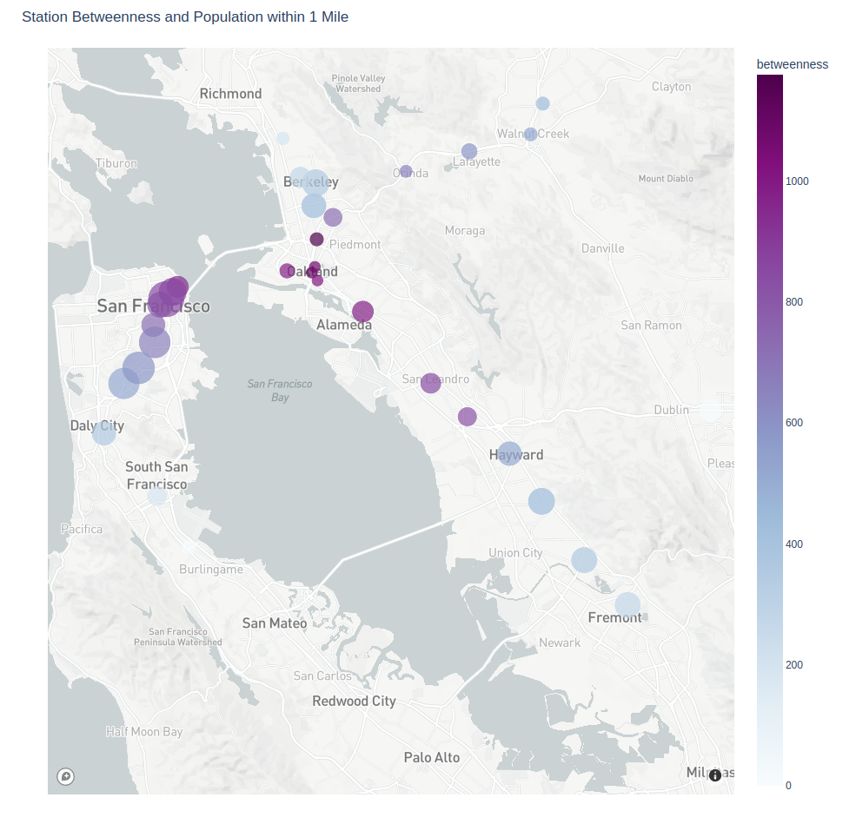
PHASE 1: BART
TARGET
01.
Bart Stations that have a high population and high betweenness with other stations.
POWELL STREET
(i) High population with 140k people located within one mile.
(ii) Central connector between other stations.
(iii) Added benefit of being located in business district.
02.
FRUITVALE STATION
(i) High population with 52k people located within one mile.
(ii) Central connector between other stations.
Notes:
Joe
Target Population and Betweeness

Slide 8
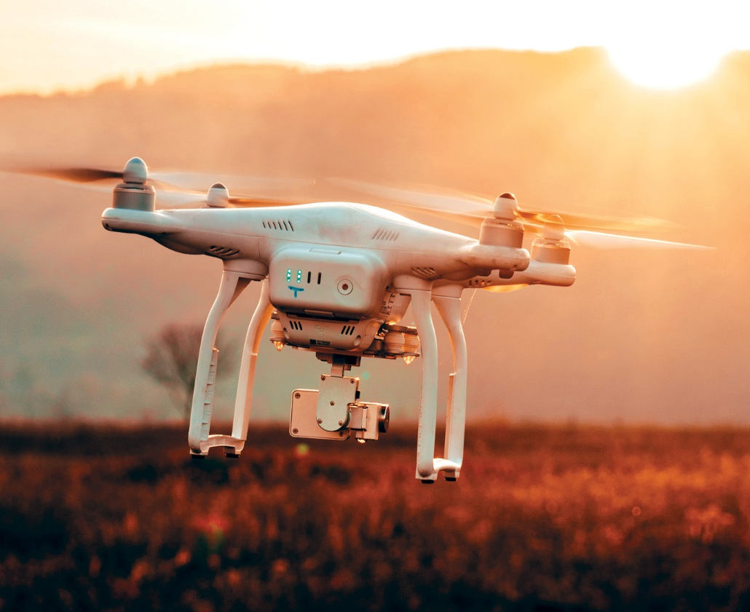

PHASE 2: ADDITIONAL DELIVERY SYSTEMS
Drones & Robots
To cater to the Non-Bart population, we propose using drones and delivery bots so as to maximize efficiencies and speed time to delivery
Drones can be used from remote delivery in suburban areas while robots can be used for more urban settings that do not have immediate Bart locations
EFFICIENT DELIVERY
Notes:
Joe
Test market on Drone and Robot deliveries

Slide 9
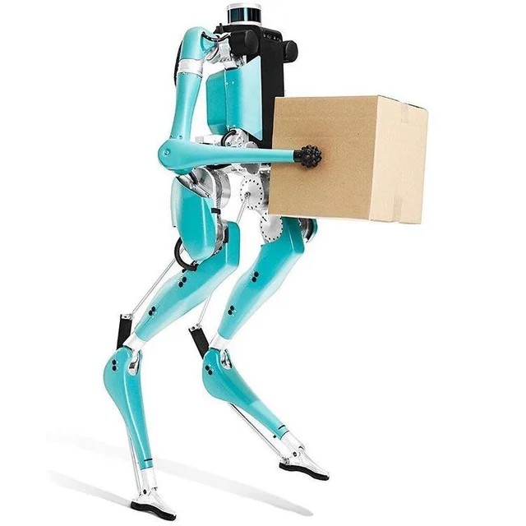

PHASE 2: COST OF ALTERNATIVE DELIVERY SYSTEMS
DRONES
We estimate each drone delivery to cost around $5 per package
To begin building and testing a fleet, we recommend buying 3 camera drones, which cost about $400 per drone
ROBOTS
(i) We recommend purchasing a mix of both long range and short range robots, which we project to incur costs of $2.5k to $5k per robot
Notes:
Joe

Slide 10
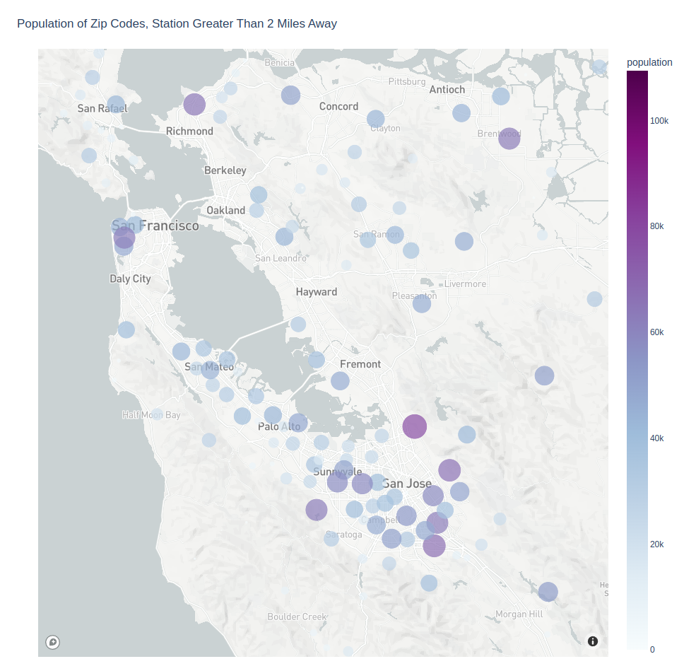
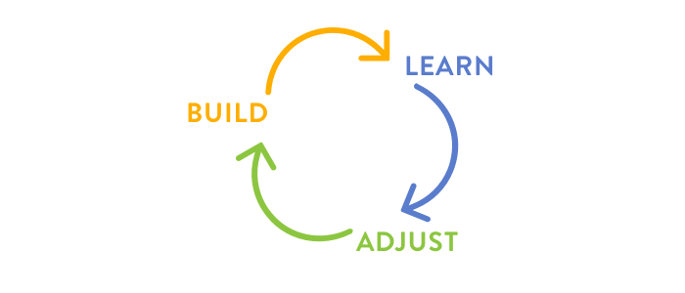


PHASE 3: STORE FOOTPRINT EXPANSION & ITERATE
Iterate
Two-pronged approach to store footprint expansion:
Seeking densely populated areas with no train access and limited store alternatives
San Jose, CA
San Mateo, CA
San Francisco, CA
Notes:
Joe
Larger population hubs not near Bart Stations

Slide 11

INVENTORY TRACKING
ROUTE OPTIMIZATION
Reduce manual error, minimize order cancellations, and identify inventory shrinkage
Modelling for shortest delivery times and minimal interference
PHASE 4: CONTINUOUS SUPPLY CHAIN OPTIMIZATION THROUGH LIVE DATABASES
INVENTORY OPTIMIZATION
LIVE DELIVERY TRACKING
Extending the working capital and cash conversion cycle through forecasting
The logistics team and customers can be informed on live deliveries through our enhance delivery systems (drones and bots)
Notes:
Joe
Iterate and Optimize

Slide 12

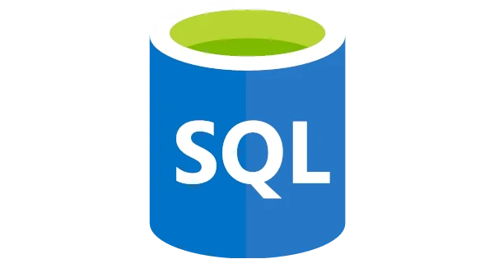



LEVERAGING TECHNOLOGIES
Leveraging a full suite of technology stacks to drive innovation
Measuring connections and characteristics of stores, BART stations and alternative delivery systems
Highly normalized transactional database for all operations.
Analytical dashboards to drive business viewpoints, capital allocation, and mix shifts
Real time date based on inventory, wait times, and sales
Notes:
Che

Slide 13
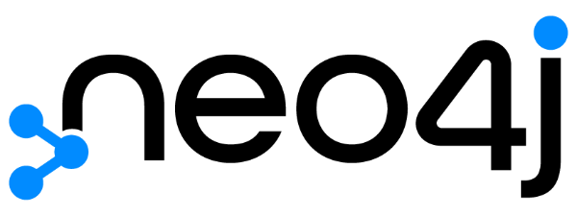
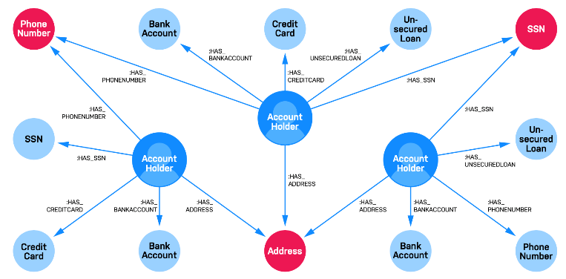
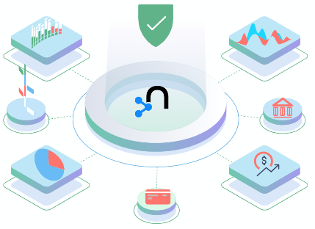
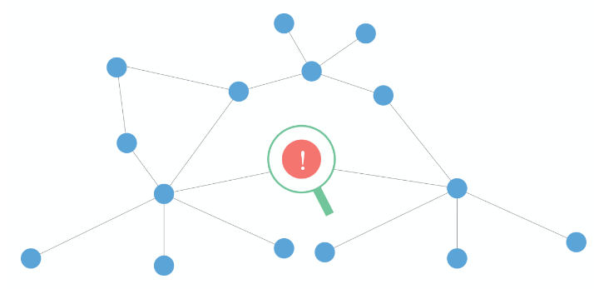

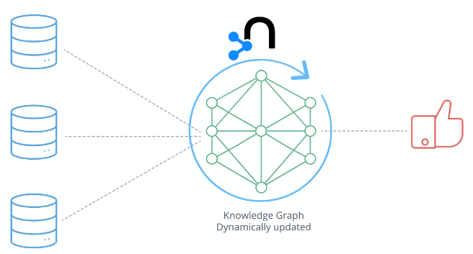
neo4j
Relational databases aren’t designed to capture rich relationship information. Applications are missing out on critical connections essential for today’s high-stakes, data-driven decisions.
Neo4j graph data science makes it easier to unlock answers as it puts relationships first. It also allows one to use graph queries and algorithms to further investigate data and prepare features for ML models to use.
A Business Use Case: Identifying First-Party Fraud
Graph Technology in Financial Services
An individual or group of people may misrepresent their identity or use false information when applying for a financial product or service. An estimated 80% of all credit card fraud losses stem from this synthetic identity fraud which results in major losses for financial institutions.
To detect such first-party fraud efficiently and effectively, Neo4j allows one to use graph queries and algorithms to investigate data, get a sense of its structure and discover patterns and anomalies.
One can use Neo4j Bloom to visually explore results and verify first-party fraud. A more advanced approach is to apply neo4j graph algorithm to create features and use them to machine learning model to identify more fraud faster.
Stay Agile in Risk & Compliance
Fraud Detection
Capture a 360 Customer View
Leverage Data across Team
Notes:
Che

Slide 14
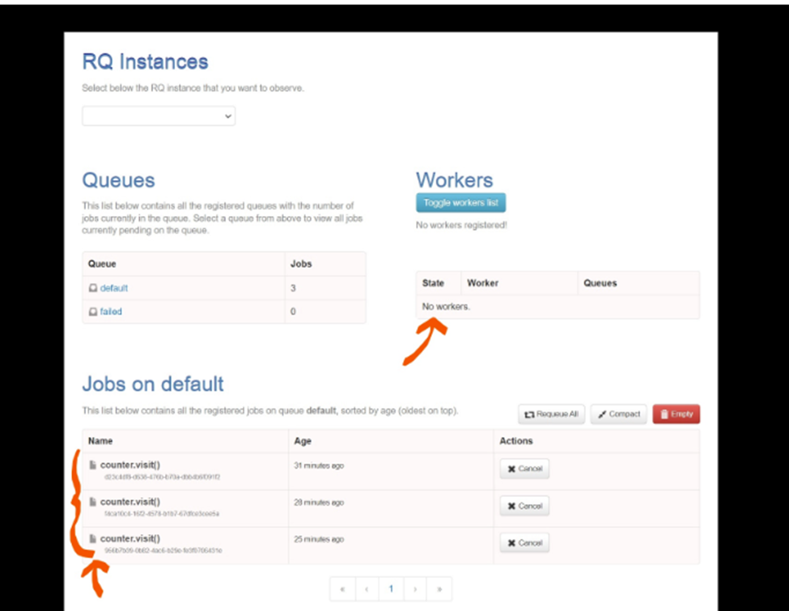
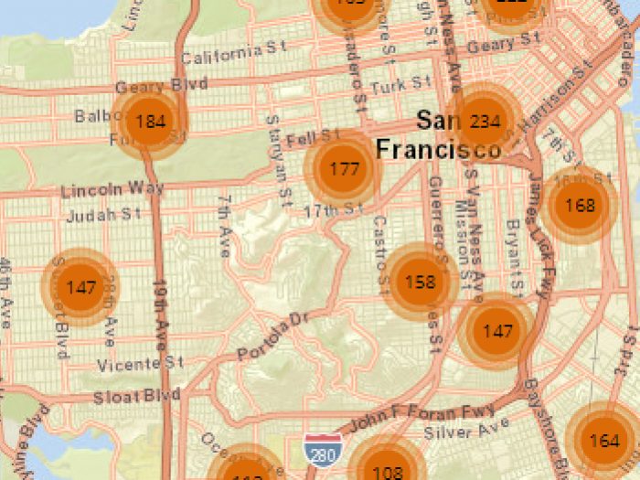
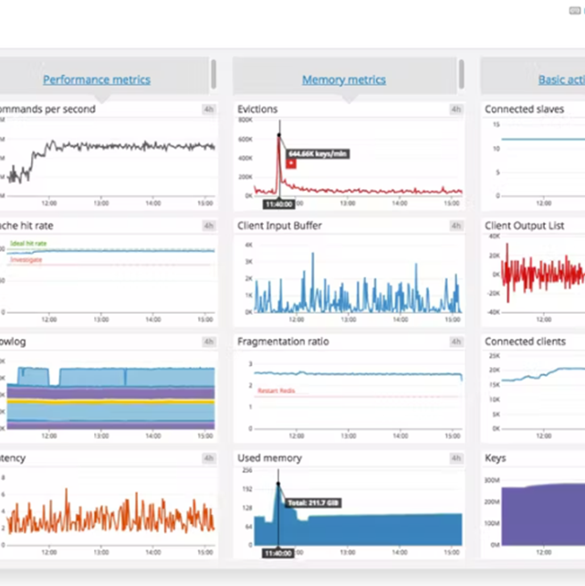
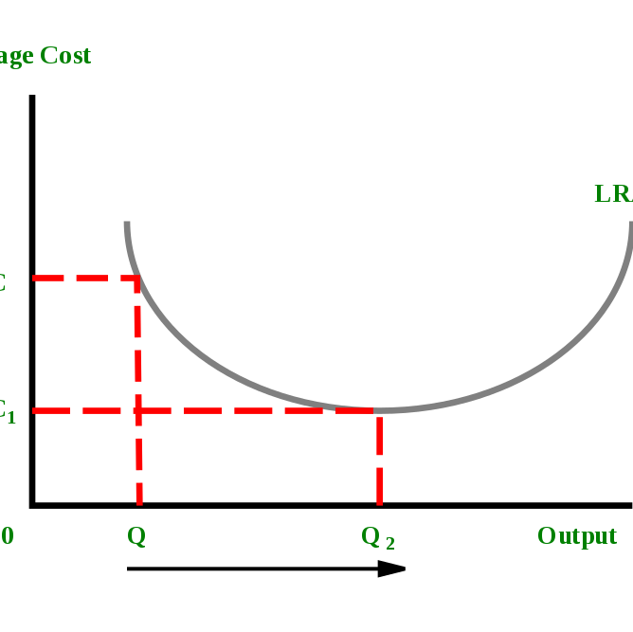
LIVE USAGE DASHBOARD
OPTIMAL SCALE OUT
Showing performance, memory, activity metrics
Sequentially copying of the file system of the master container into the newly created nodes
Redis is an open source, in-memory data structure server which leverages key-value pairs. The Redis stack permits the real time building of applications with searchable JSON, time series and graph data models, as well as high performance probabilistic data structures.
Scaling out a NoSQL database that holds username and passwords for secure log-ins to protect against cyber-attacks
Post log-in, users would have the ability to see a full product list, delivery routes, and other alternative data
A stateful web server because it can track and hold session data for every transaction, allowing for optimal scale out
SECURE USER LOGINS
INFORMATION ACCESS
USE CASE
Protecting against cyber-attacks with no way for others to reverse passwords
Once logged in, users can access a full list of inventory, delivery pipeline and routes
Notes:
Che

Slide 15
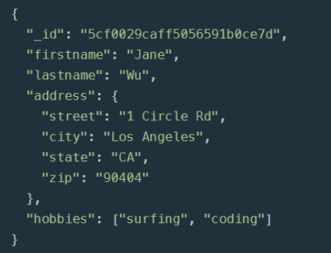

Example: Store and Retrieve all data about each of our customers.
Mango is an open source, data structure server which leverages a json like structure to store and retrieve data. The MangoDB creates a highly efficient way to access specific analytical views of our data.
Customers
Stores
Name
Address
Email
Payment Details
…
Location
Employees
Inventory
Sales
…
Applications
Online and Stores
Executive Dashboards
Research Datastore
Engagement Surveys
Sales Forecasting
Employee Specific
…
Transactions
Analytics
Customer
Sales Employee
Store
Order Details
…
Sales Trends
Inventory Mgmt.
Predictions
Customer Scores
…
Notes:
Che

Slide 16
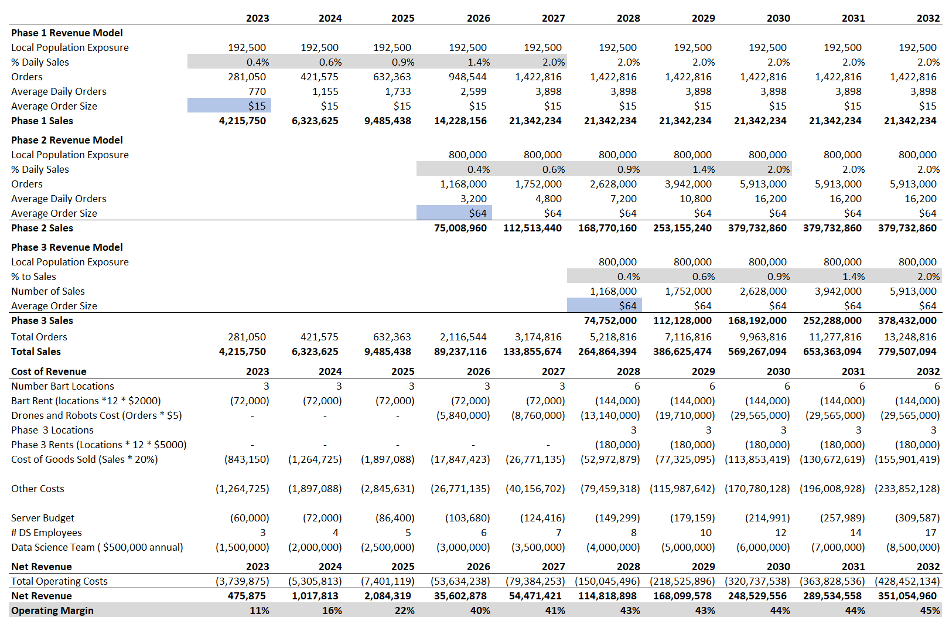
FINANCIAL PROJECTIONS
An investment in the data science team represents a significant opportunity from a business perspective
Driving increased sales growth, longer-run operating margins in excess of 40% , and the ability to scale efficiently
Perception of AGM as a technology-enabled company could lead to multiple re-rating
Notes:
Joe

Slide 17
Questions?

